Slide 1

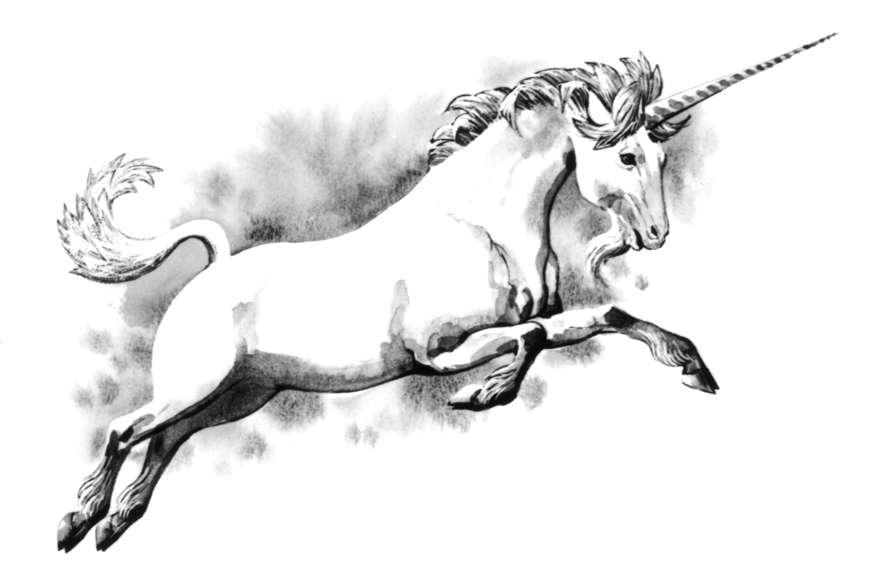
Binary Bastards

Slide 2



















Slide 3


Slide 4


Slide 5
Great Job! Level Complete

Slide 6
Game Over!

